Slide 1
HR Analytics Case
Group Name:
Naveen Masali
Nikhil Tiwari
Sagar Sheth
Rahul Varaganti
XYZ Org.

Slide 2
XYZ org. at a Glance
4000 + employees
Annual attrition rate close to 15%
Attrition is high, and management is concerned

Slide 3
Our Approach
Problem Definition – “Higher Attrition Rate”
Understanding Objectives and expectations
Data collection, import in Platform and Data Understanding
Our Assumptions
Data Cleaning and creation of derived metrics, if any
Conducting Exploratory Data analysis along with relevant Data preparation
Collating Data in a Master File for Model Development
Identifying Predictor and Response Variables
Splitting Data in to Training and Test Data set randomly
Developing the model based on training set
Fine Tuning the model without overfitting
Selection of most appropriate model based on algorithm and Statistical criterion
Prediction from test set
Assessment of Quality of Prediction of Response Variable
Final Recommendations

Slide 4
Why concern?
High attrition results in
Project delays
Missing Deadlines and loss of business
Loss of reputation among accounts
Increased new recruitment cost and high HR department overheads
Further additional Training and Development expenses
Negative motivation levels among current employees

Slide 5
Why HR Analytics Intervention
To understand
Factors to focus on for curbing attrition rate from growing
What changes are to be made in workplace environment to minimise attrition
Priorities among factors attributing high attrition to attend them immediately.
As a top rated analytics talent in the firm, this assignment has been bestowed on us.

Slide 6
Assignment Objectives
Developing a model of the ”Probability of Attrition”
Method for designing model - Logistic Regression

Slide 7
Deliverables
The Attrition Probability Model based on logistic regression, which will help attaining results to
Understand major drivers (factors) for high attrition rate
What fine tuning is required in workplace settings, to keep the employees from quitting.

Slide 8
The Data Gathered
The Manager Survey Data – Collected from a company wide survey.
The Employee Survey Data – Collected from a company wide survey.
In-Time Data – Collected from company’s attendance Log sheet/ Machine
Out – Time Data – Collected from company’s attendance Log sheet/ Machine
General Data – General data includes employee wide their personal data along with education and their satisfaction level for association with XYZ org, etc. This data has following fields

Slide 9
Rstudio
All the five tables have been imported in Rstudio.
Data has been directly viewed in to grab basic understanding, and
Necessary assumptions for data cleaning and handling are made
Data Import and basic understanding

Slide 10
Assumptions
Mandatory Holidays are worked out as the days on which entire column has missing value and And also which weren't weekends, are considered as Holiday namely
X2015.01.01, X2015.01.14, X2015.01.26, X2015.03.05, X2015.05.01

Slide 11
Data Cleaning and Derived Metrics
In this step we have formatted the in time and out time in date and time format for the entire period.
We also removed following dates from data based on our assumption
X2015.01.01, X2015.01.14, X2015.01.26, X2015.03.05, X2015.05.01
Below is the list of categorical attributes
Attrition, Gender, Over18 -- 2 levels
More than 2 levels -- EnvironmentSatisfaction, JobSatisfaction, WorkLifeBalance, JobRole, MaritalStatus, BusinessTravel, Department,Education, EducationField, JobInvolvement, JobLevel, PerformanceRating
Among all variable attrition is our categorical response variable and rest are predictor variables.

Slide 12
Designing Derived Metrics
Over time : If the average work hours for an employee is greater than the standard work hours i.e. 8 then the employee works overtime on an average.
Inadequate Work hours : If the average work hours for an employee is considerably less standard work hours i.e. less than 7 then the employee on an average has inadequate work hours.
No of Leaves : If the employee has NA values for in time for a day which is not an assumed holiday or a weekend. The employee is assumed to be on leave on that day. The Count of all the NA values for each employee which isn’t an assumed Holiday or weekend is taken as no of leaves.

Slide 13
Data preparation and related EDA
All the data files have been merged to form a core data file for analysis
Distribution of categorical variables have been done to see outlier pattern
NA from numerical predictors have been filtered and reassigned by median and means adequately
For Attrition, Gender, Over18 -- as these are having 2 levels these being realigned as numerical Yes ==1 and No == 0
Dummy variables for following categorical predictors have been creates
More than 2 levels -- EnvironmentSatisfaction, JobSatisfaction, WorkLifeBalance, JobRole, MaritalStatus, BusinessTravel, Department,Education, EducationField, JobInvolvement, JobLevel, PerformanceRating
Final dataset has been achieved after this preparation exercises and outliers have been checked and deliberately kept as in our view it is not wise to remove them, since in normal scenario they will be there and represent the company population where such data is bound to exist.
Relevant predictors have been scaled to aid in regression modelling and to avoid power effects, which are Salary, Age.

Slide 14
Our Response variable is “Attrition” (1 == Yes, & 0 == No)
Final Dataset == hr_analytics_scaled
Rest all non constant numeric variables are scaled to aid in regression modelling.

Slide 15
Approach for logistic regression
For creating Train and test datasets from final data set:
We fixed seed to 100
Used split ratio of 0.7 for training dataset and remaining data has been assigned to test dataset
Initial model has been conceived with GLM function, then StepAIC has been applied to arrived at standard model which yielded on iterative predictor selection with out major reduction in AIC Score (2024.2 after 6 scoring iterations).
Then based on VIF (variance inflation factor) and P value (with significance) predictors have been filtered and after another 16 iterations we could achieve our final model. with almost all predictors being significant with lowest VIF are present.

Slide 16
Final Logistic Regression Model
Assessment_Model = glm(formula = Attrition ~ NumCompaniesWorked + TotalWorkingYears +
YearsSinceLastPromotion + YearsWithCurrManager + Over_time +
EnvironmentSatisfaction.x2 + EnvironmentSatisfaction.x3 +
EnvironmentSatisfaction.x4 + JobSatisfaction.x2 + JobSatisfaction.x3 +
JobSatisfaction.x4 + WorkLifeBalance.x2 + WorkLifeBalance.x3 +
WorkLifeBalance.x4 + BusinessTravel.xTravel_Frequently +
JobRole.xManufacturing.Director + MaritalStatus.xSingle,
family = "binomial", data = train)

Slide 17
Prediction based on final model
Confusion Matrix
Prediction | Reference
 | No | Yes | Total
No | 819 | 54 | 873
Yes | 275 | 175 | 450
Total | 1094 | 229 | 1323
Prediction Statistics:
Accuracy : 0.7513
95% CI : (0.7271, 0.7744)
No Information Rate : 0.8269
P-Value [Acc > NIR] : 1
Kappa : 0.3712
Mcnemar's Test P-Value : <2e-16
Sensitivity : 0.7642
Specificity : 0.7486
Pos Pred Value : 0.3889
Neg Pred Value : 0.9381
Prevalence : 0.1731
Detection Rate : 0.1323
Detection Prevalence : 0.3401
Balanced Accuracy : 0.7564
'Positive' Class : Yes

Slide 18
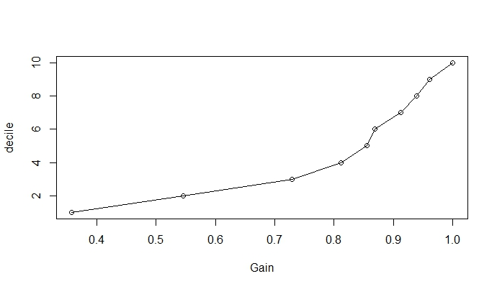
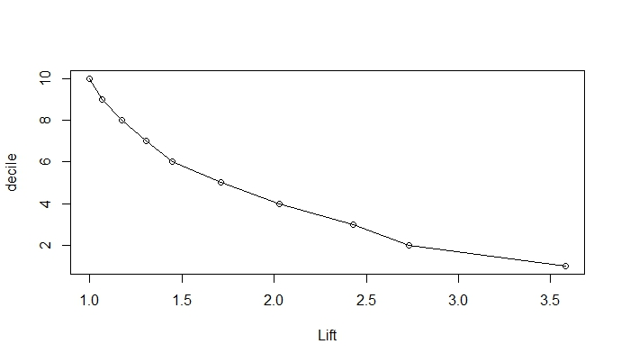
Model Assessment (GAIN & LIFT charts)
Decile | Observations | Churn | Cum- Churn | Gain(%Cum-Churn) | Gain (Random Model) | Lift
1 | 133 | 82 | 82 | 35.8% | 10% | 3.58
2 | 133 | 43 | 125 | 54.6% | 20% | 2.73
3 | 133 | 42 | 167 | 72.9% | 30% | 2.43
4 | 132 | 19 | 186 | 81.2% | 40% | 2.03
5 | 132 | 10 | 196 | 85.6% | 50% | 1.71
6 | 132 | 3 | 199 | 86.9% | 60% | 1.45
7 | 132 | 10 | 209 | 91.3% | 70% | 1.30
8 | 132 | 6 | 215 | 93.9% | 80% | 1.17
9 | 132 | 5 | 220 | 96.1% | 90% | 1.07
10 | 132 | 9 | 229 | 100.0% | 100% | 1.00
Total | 1323 | 229

Slide 19
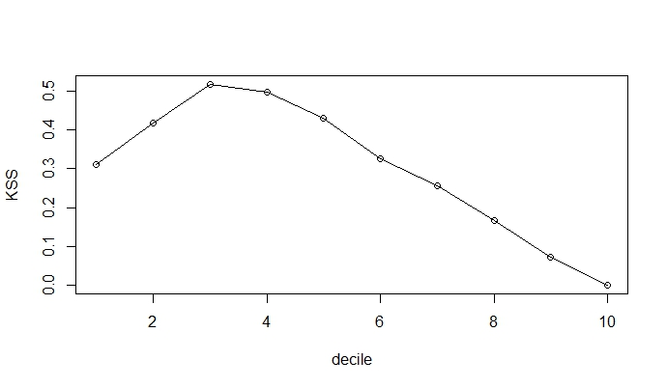
Model Assessment (KSS)
Decile | Observations | Churn | Cum- Churn | % Cum-Churn | Non- Churn | Cum-Non-Churn | %Cum-Non-Churn | (%Cum-Churn) - (%Cum-Non-Churn)
1 | 133 | 82 | 82 | 35.8% | 51 | 51 | 4.7% | 31.1%
2 | 133 | 43 | 125 | 54.6% | 90 | 141 | 12.9% | 41.7%
3 | 133 | 42 | 167 | 72.9% | 91 | 232 | 21.2% | 51.7%
4 | 132 | 19 | 186 | 81.2% | 113 | 345 | 31.5% | 49.7%
5 | 132 | 10 | 196 | 85.6% | 122 | 467 | 42.7% | 42.9%
6 | 132 | 3 | 199 | 86.9% | 129 | 596 | 54.5% | 32.4%
7 | 132 | 10 | 209 | 91.3% | 122 | 718 | 65.6% | 25.6%
8 | 132 | 6 | 215 | 93.9% | 126 | 844 | 77.1% | 16.7%
9 | 132 | 5 | 220 | 96.1% | 127 | 971 | 88.8% | 7.3%
10 | 132 | 9 | 229 | 100.0% | 123 | 1094 | 100.0% | 0.0%
Total | 1323 | 229 |  |  | 1094

Slide 20
Model Assessment Summary
The model has an increasing Gain and a decreasing Lift.
The Model predicts more than 80% of the attritions within the 4th Decile with 75% accuracy.
The KS statistic shows that the model is very good in distinguishing between employees who will leave the company and employees who won’t.

Slide 21
Final Predictors Correlations
Column | COR
NumCompaniesWorked | 0.04223153
TotalWorkingYears | -0.1701114
YearsSinceLastPromotion | -0.03301878
YearswithCurrManager | -0.1561993
Over_time | 0.2304676
BusinessTravel.xTravel_Frequently | 0.1151428
JobRole.xManufacturing.Director | -0.0457701
MaritalStatus.xSingle | 0.1754186
EnvironmentSatisfaction | -0.1016252
JobSatisfaction | -0.1030683
WorkLifeBalance | -0.06297476

Slide 22
Recommendations
Environment Satisfaction, Job Satisfaction and Work life balance, the better these are for employees the less are their chances of leaving the company.
The more an employee works overtime on an average the more are the chances that he/she will leave the company.
If an employee works with the same manager for a longer period of time the lesser are the chances that employee will leave the company.
Hire people with more experience as they are less likely to leave the company. But if the person has worked in many companies then the chances that he/she will leave the company increases.
Employees who are unmarried are prone to leaving the company.

Slide 23
Thank you

